Slide 1
Southern Water Corp – Technical Presentation
Date:
Presenter: Danny Hua

Slide 2
Executive Summary
FOCUS: What variables are correlated to pump failure?
Pump failure is causing an increase in costs
Overall operating expenses is forecast to increase by 53% and overall rolling cost to produce is expected to rise from $33.67/megalitre to $71.68/megalitre
The rise in costs will make it difficult for Southern Water Corp to break-even and price competitively, especially when the market price is expected to be at around $53.98/megalitre
Our goal is to to keep costs to a minimum and prevent our plants from failing in the first place (or minimize the damages)
Through descriptive and inferential statistics analysis we concluded that SURJEK PUMP TORQUE, MAXIMUM DAILY PUMP TORQUE, and SURJEK FLOW METER 2 are the three variables that are highly correlated to pump failure
Notes:
Plant failure -> shut down for maintenance we will lose out on revenue from desalinated water sales

Slide 3
Through the utilization of descriptive and inferential statistics, we identified three variables with high correlation to pump failure. The multivariate regression equation will help us identify abnormal behaviour that will lead to pump failure
Key Insights
After analysing the dataset for Surjek desalination plant we have identified that SURJEK PUMP TORQUE, MAXIMUM DAILY PUMP TORQUE, and SURJEK FLOW METER 2 are the top 3 variables that are highly correlated (> 0.5) to pump failure
The regression model produced an R Square value of 0.536
With more data, improvements could be made to the model to achieve a higher R Square and improve accuracy
There are smaller spikes that occurred before the big spike. Further analysis can be done to see if that is an early indication of a pump failure
Notes:
Although only 54% of the values fit the regression model, this is better than having nothing. We have a better chance now to prevent future pump failure and minimize maintenance costs. With more data we can improve the regression model.

Slide 4
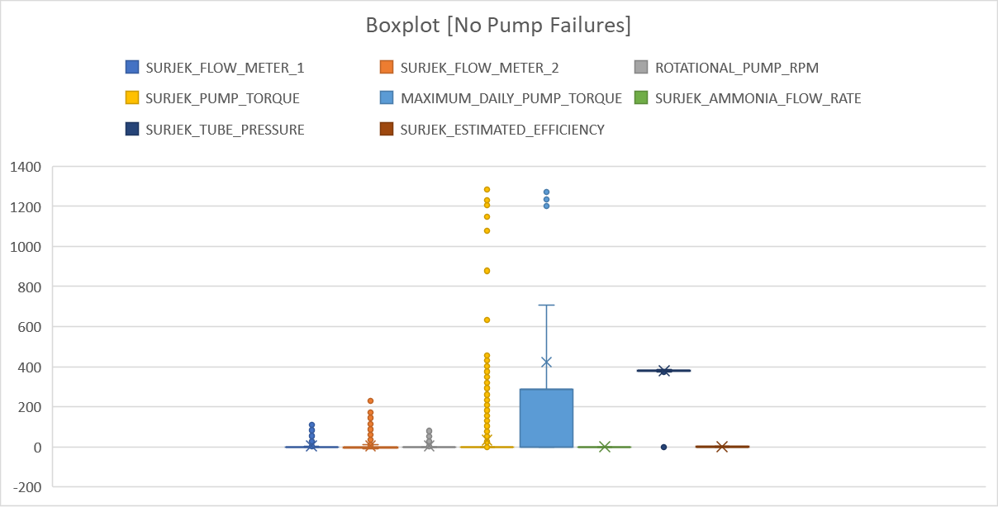
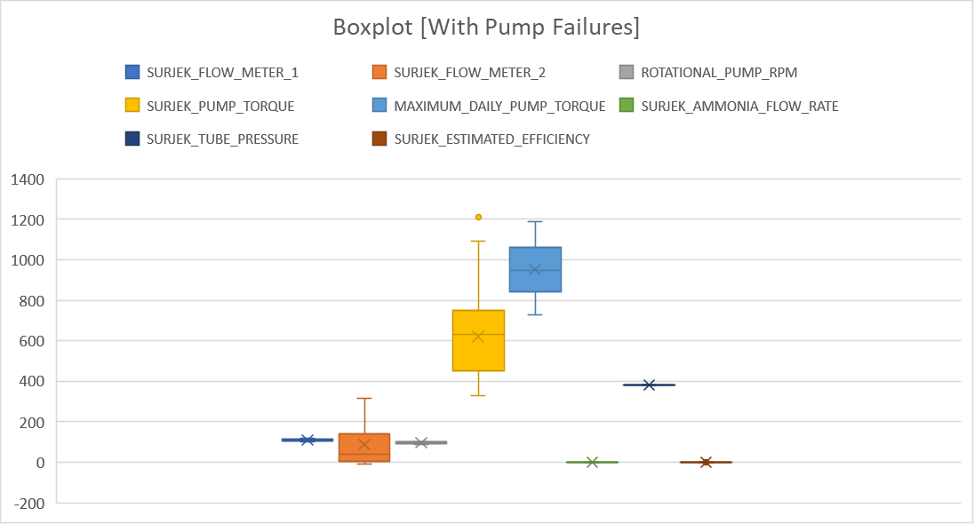
From our descriptive statistics analysis, Surjek Flow Meter 2, Pump Torque, and Maximum Daily Pump Torque are variables that stood out
Key Insights
The graph on the left shows what the variables are like when the plant is functioning normally
The graph on the right shows large variation across 3 noticeable variables when there is a pump failure
Notes:
We see on the left graph that interquartile range is very slim for most of the variables when there is no failure.
On the right graph we can see that the interquartile range beings to spread for some of the variables when there is a pump failure with 3 of the variables standing out the most.

Slide 5
Using inferential statistics we were able to identify 3 variables that are strongly correlated to pump failure, which backed up our descriptive statistics analysis (boxplots) findings
Key Insights
After the correlation was calculated we identified SURJEK PUMP TORQUE, MAXIMUM DAILY PUMP TORQUE and SURJEK FLOW METER 2 as the top 3 variables that are highly correlated (> 0.5) to pump failure
Notes:
To further back up our boxplot analysis we calculated the correlation to determine which variables are highly correlated to pump failure. The result that we got backed up our hypothesis when we did our boxplots.

Slide 6
Conclusion / Solution
We now know that SURJEK PUMP TORQUE, MAXIMUM DAILY PUMP TORQUE and SURJEK FLOW METER 2 are the three variables that are highly correlated to pump failure
With the information that we know, we should work with the engineers to see if any upgrades can be done to prevent future malfunctions or lessen the damages
With less pump failures it will (i) help minimize overall costs and (ii) allows Southern Water Corp to price competitively in a market with rising competition

